Slide 1
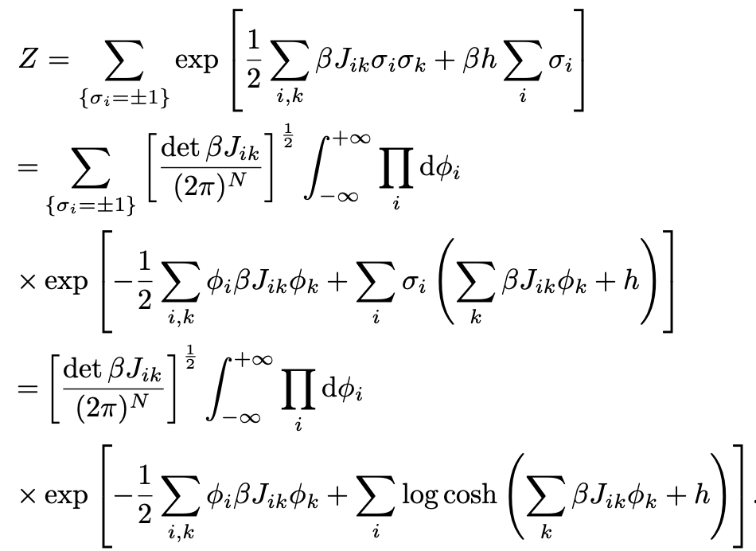
From the Ising model to Ginzburg-Landau
Hubbard-Stratonovich approximation
Rewrite the exponential of the Ising Hamiltonian in terms of a Gaussian integral and perform the summation over all spin configurations in the partition function Z
Take the continuum limit
Point (1) ->

Slide 2
From the Ising model to Ginzburg-Landau
Hubbard-Stratonovich approximation
Rewrite the exponential of the Ising Hamiltonian in terms of a Gaussian integral and perform the summation over all spin configurations in the partition function Z
Take the continuum limit
Point (2):
Consider the term in the cosh and take its Taylor expansion and outside: “a” is the lattice constant, “z” is the coordination number of the lattice node
The you consider the Taylor expansion of the cosh
The you compute the free-energy and get all the usual terms of the Ginzburg-Landau
Nearest-neighbors

