Slide 1
Deriving the LBM force term through a lattice gas model with molecular dynamics collision operator
Hamed Vaseghnia
Department of Energy resources
University of Stavanger.
Discrete Simulation of Fluid Dynamics workshop
North Dakota State University
Fargo, ND, USA
June 27 - July 1, 2022

Slide 2
Contents
Introduction
Forcing term
Lattice gas
Molecular dynamics
MDLG
Motivation
Force term in LBM
Overview
Lattice gas with molecular dynamics collision operator
Equilibrium Ideal gas system
Objectives
Ideal gas system with gravitational force

Slide 3

Introduction
Force term:
In many hydrodynamic problems (Multiphase flows, Viscoelastic fluid flows, Pore-scale simulations, immersed boundaries and moving walls etc.), forces are crucial.
$F=ρg$ (gravity) $F=∇.τ_{αβ}$ (Elastic force)
Any free body force may be used to represent the driving mechanism of the pressure gradient field in incompressible flows.
LBM takes its effectiveness from an underlying mesoscopic characterization that guarantees correct conservation of mass and momentum.
When solving pressure fields, the LB approach may become inaccurate because of compressibility errors.
i.e.
(1)
Deriving the LBM force term through a lattice gas model with molecular dynamics collision operator

Slide 4
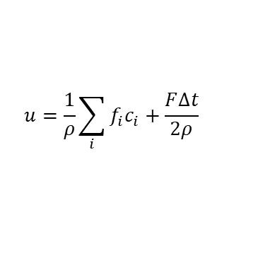



Introduction
Forcing in Lattice Boltzmann method :
Expressing forces, assuming the BGK collision operator.
$$ρ=\sum_{i}{f_{i}}$$
$$u=\frac{1}{ρ}\sum_{i}{f_{i}c_{i}+\frac{F∆t}{2ρ}}$$
(2)
(3)
$$S_{i}=\left(1−\frac{∆t}{2τ}\right)w_{i}\left(\frac{c_{iα}}{c_{s}^{2}}+\frac{(c_{iα}c_{iβ}−c_{s}^{2}δ_{αβ})u_{β}}{c_{s}^{4}}\right)F_{α}$$
(4)
This source term can be related to the forces as:
$$S_{i}=(1−\frac{1}{2τ})F_{i}$$
(Gou & Shi, PR E, Vol 65, 2002)
Deriving the LBM force term through a lattice gas model with molecular dynamics collision operator

Slide 5
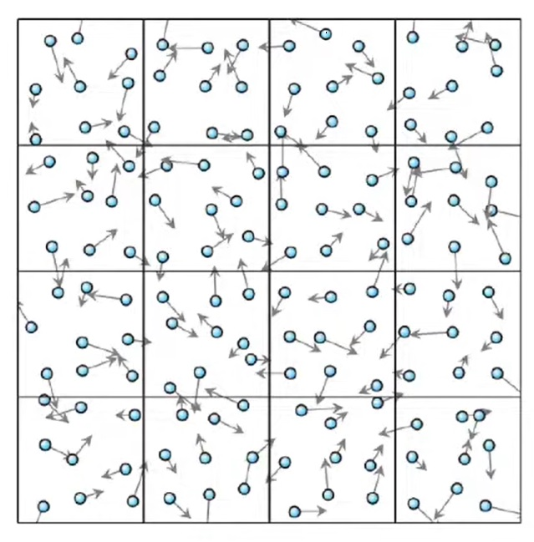
Introduction
Lattice gas:
Developed as a theoretical tool for the evaluation of lattice gas techniques.
Stream: Particles moving on a lattice at speeds that connect nearby sites make up lattice gas approaches.
Collide: After the particles have migrated, they are rearranged by a probabilistic collision process.
Hydrodynamics limit for the mass and momentum conservation equation if these collisions preserve both the quantity of particles and the overall momentum.
Huge quantity of noise that was enormous and practically uncontrollable and necessitated a lot of averaging.
A theoretical ensemble averaging was carried out, resulting to a lattice Boltzmann representation, to derive the Navier-Stokes equations from the lattice gas dynamics.
Fig 1. Sketch of lattice gas
Deriving the LBM force term through a lattice gas model with molecular dynamics collision operator

Slide 6
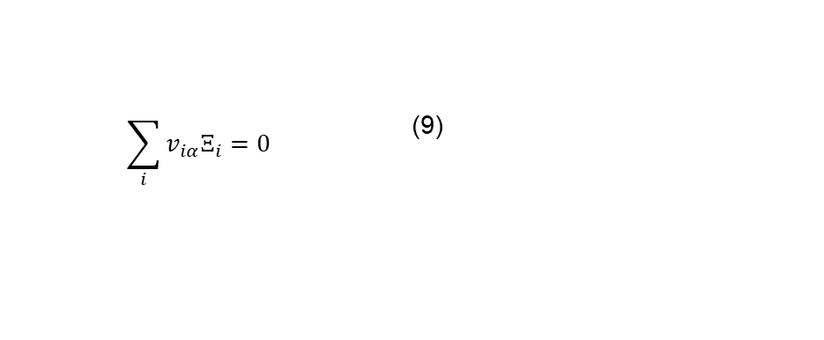



Introduction
Lattice gas:
Particles that move with a lattice velocity $v_{i }$and are all situated on lattice points.
The definition of local mass and momentum densities is
These quantities conservation implies:
$$n_{i}\left(x_{i}+v_{i}, t+1\right)=n_{i}\left(x_{i},t\right)+Ξ_{i}$$ | (5)
$ρ=\sum_{i}{n_{i}}$ | (6)
$$ρu_{α}=v_{iα}n_{i}$$ | (7)
$$\sum_{i}{Ξ_{i}=0}$$ | (8)
$$\sum_{i}{{v_{iα}Ξ}_{i}=0}$$ | (9)
Deriving the LBM force term through a lattice gas model with molecular dynamics collision operator

Slide 7
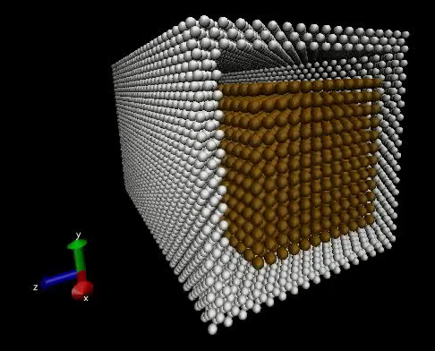
Introduction
Molecular Dynamics
A crucial theoretical tool that enables researchers to simulate the microscopic dynamics of many complex systems.
is a relatively straightforward microscopic technique that monitors the movement of particles that often stand in for atoms or molecules.
In MD, the precise microscopic behavior of the given system is described by solving the equations of motion for each individual atom.
Is expected to produce accurate results over a wide range of conditions and timescales.
Fig 2. Three-dimensional simulation of Poiseuille flow using MD
Deriving the LBM force term through a lattice gas model with molecular dynamics collision operator

Slide 8
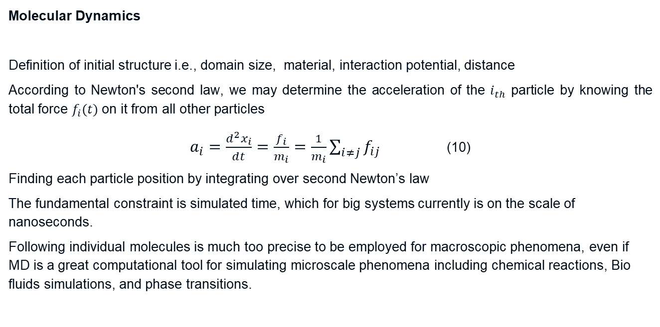
Introduction
Molecular Dynamics
Definition of initial structure i.e., domain size, material, interaction potential, distance
According to Newton's second law, we may determine the acceleration of the $i_{th}$ particle by knowing the total force $f_{i}(t)$ on it from all other particles
$a_{i}=\frac{d^{2}x_{i}}{dt}=\frac{f_{i}}{m_{i}}=\frac{1}{m_{i}}\sum_{i≠j}{f_{ij}}$ (10)
Finding each particle position by integrating over second Newton’s law
The fundamental constraint is simulated time, which for big systems currently is on the scale of nanoseconds.
Following individual molecules is much too precise to be employed for macroscopic phenomena, even if MD is a great computational tool for simulating microscale phenomena including chemical reactions, Bio fluids simulations, and phase transitions.
Deriving the LBM force term through a lattice gas model with molecular dynamics collision operator

Slide 9
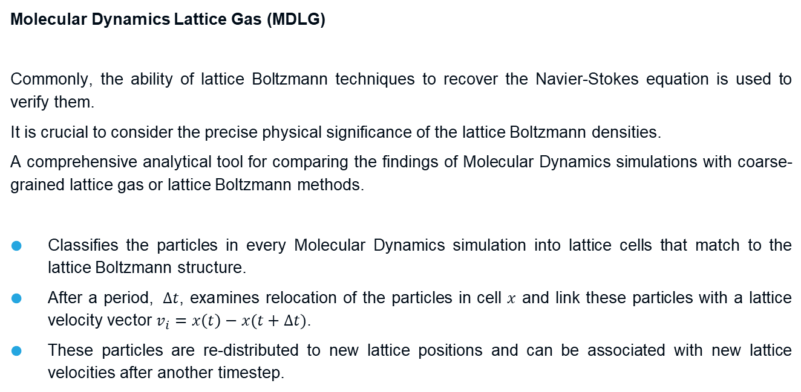
Introduction
Molecular Dynamics Lattice Gas (MDLG)
Commonly, the ability of lattice Boltzmann techniques to recover the Navier-Stokes equation is used to verify them.
It is crucial to consider the precise physical significance of the lattice Boltzmann densities.
A comprehensive analytical tool for comparing the findings of Molecular Dynamics simulations with coarse-grained lattice gas or lattice Boltzmann methods.
Classifies the particles in every Molecular Dynamics simulation into lattice cells that match to the lattice Boltzmann structure.
After a period, $∆t$, examines relocation of the particles in cell $x$ and link these particles with a lattice velocity vector $v_{i}=x\left(t\right)−x(t+∆t)$.
These particles are re-distributed to new lattice positions and can be associated with new lattice velocities after another timestep.
Deriving the LBM force term through a lattice gas model with molecular dynamics collision operator

Slide 10
Introduction
Because the dynamics of this type of lattice gas are totally provided by the MD simulation, it’s able to provide a coarse-grained representation for any findings obtained by MD simulations.
comparable to the direct simulation Monte Carlo (DSMC) method:
Particle-based methods in which a grid is established on the lattice.
Two particle collisions between random particles inside one cell are made.
Kinetic theory is used to reconstruct the Navier-Stokes equation
Fundamentally different:
Computationally expensive as it continues to track the precise MD result.
Analyzing lattice gas and lattice Boltzmann methods
Deriving the LBM force term through a lattice gas model with molecular dynamics collision operator

Slide 11
Motivation
Forcing in Lattice Boltzmann method :
The LB algorithm's force implementation must thus be properly discussed.
We aim to analyze LBM force term for an ideal gas system through a lattice gas with molecular dynamics collision operator algorithm.
Because it enables the description of any system that can be simulated using MD, this can be regarded as the optimal lattice gas implementation. (M. R Parsa and A J. Wagner , PR E 96, 2017)
Does not have any restriction on number of lattice velocity sets and higher order of lattice velocities can be considered (M. R. Parsa, A. Pachalieva and A. J. Wagner, Modern Physics C, Vol. 30, 2019 )
It may accurately determine the equilibrium distribution function and collision conditions of the lattice Boltzmann method in presence of forces.
Deriving the LBM force term through a lattice gas model with molecular dynamics collision operator

Slide 12
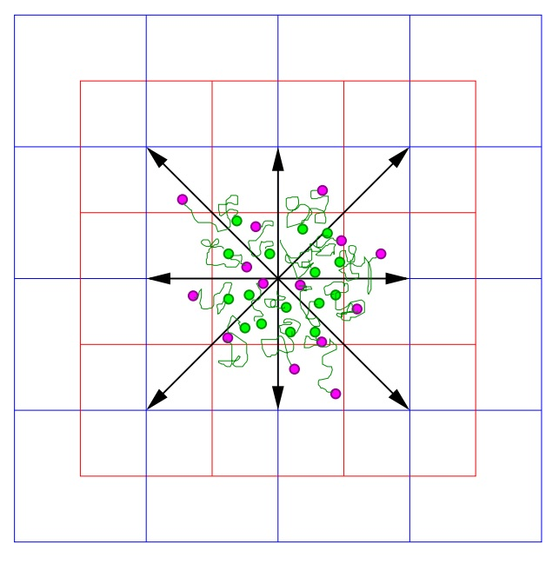

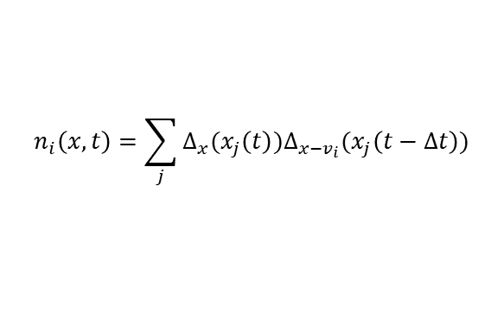
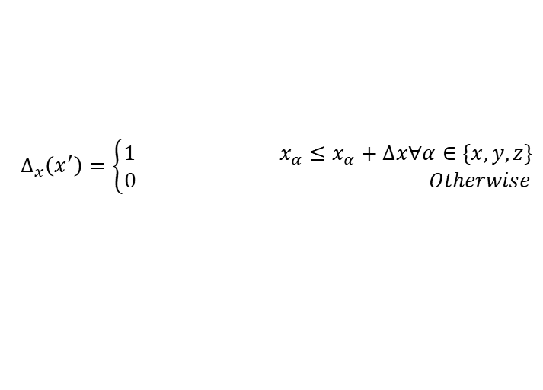
Molecular-Dynamics-Lattice-Gas
Algorithm:
$$∆_{x}\left(x^{′}\right)=\left\{\begin{aligned}1 x_{α}≤x_{α}+∆x∀α∈\{x,y,z\} \\ 0 Otherwise\end{aligned}\right.$$
(11)
$$n_{i}\left(x,t\right)=\sum_{j}{∆_{x}(x_{j}\left(t\right))∆_{x−v_{i}}(x_{j}\left(t−∆t\right))}$$
(12)
$$Ξ_{i}=n_{i}\left(x+v_{i},t+1\right)−n_{i}(x,t)$$
(13)
Spatial and temporal correlations of MD simulation
MDLG collision operators are consistent with the equilibrium behavior of the lattice gas with appropriate discretization.
Fig 3. Sketch of the MDLG algorithm
(M. R Parsa and A J. Wagner , PR E 96, 2017)
Deriving the LBM force term through a lattice gas model with molecular dynamics collision operator

Slide 13
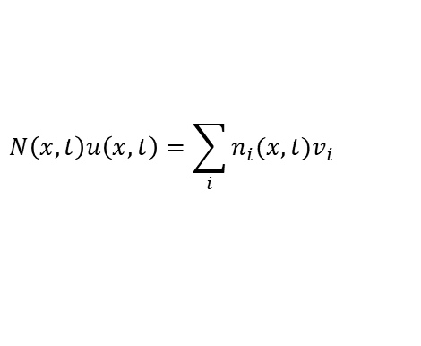
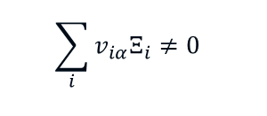

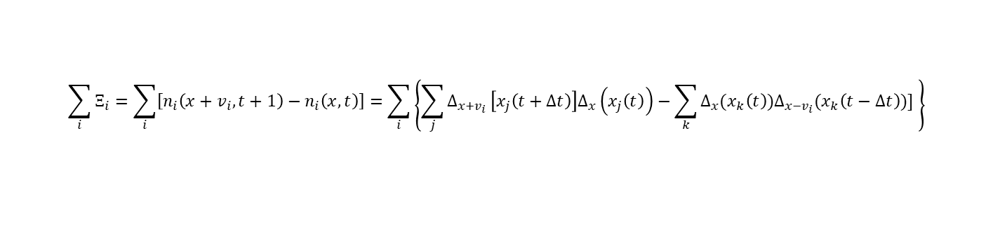
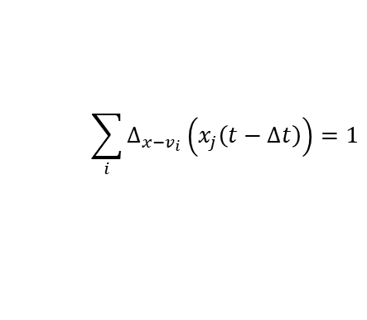
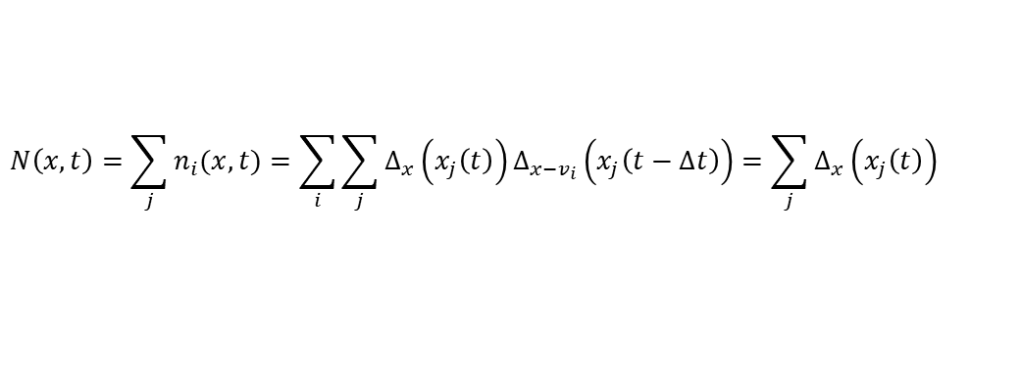
Molecular-Dynamics-Lattice-Gas
$$N\left(x,t\right)=\sum_{j}{n_{i}(x,t)}=\sum_{i}{\sum_{j}{∆_{x}\left(x_{j}\left(t\right)\right)∆_{x−v_{i}}\left(x_{j}\left(t−∆t\right)\right)=\sum_{j}{∆_{x}\left(x_{j}\left(t\right)\right)}}}$$
(14)
$$\sum_{i}{∆_{x−v_{i}}\left(x_{j}\left(t−∆t\right)\right)=1}$$
(15)
$$\sum_{i}{Ξ_{i}=\sum_{i}{\left[n_{i}\left(x+v_{i},t+1\right)−n_{i}\left(x,t\right)\right]=\sum_{i}{\left\{\sum_{j}{∆_{x+v_{i }}\left[x_{j}\left(t+∆t\right)\right]∆_{x}\left(x_{j}\left(t\right)\right)−\sum_{k}{∆_{x}(x_{k}\left(t\right))∆_{x−v_{i}}(x_{k}\left(t−∆t\right))] }}\right\}}}}$$
$$=ρ\left(x,t\right)−ρ\left(x,t\right)=0$$
(16)
$$\sum_{i}{{v_{iα}Ξ}_{i}≠0}$$
$$N\left(x,t\right)u\left(x,t\right)=\sum_{i}{n_{i}(x,t)v_{i}}$$
(17)
,
Deriving the LBM force term through a lattice gas model with molecular dynamics collision operator

Slide 14
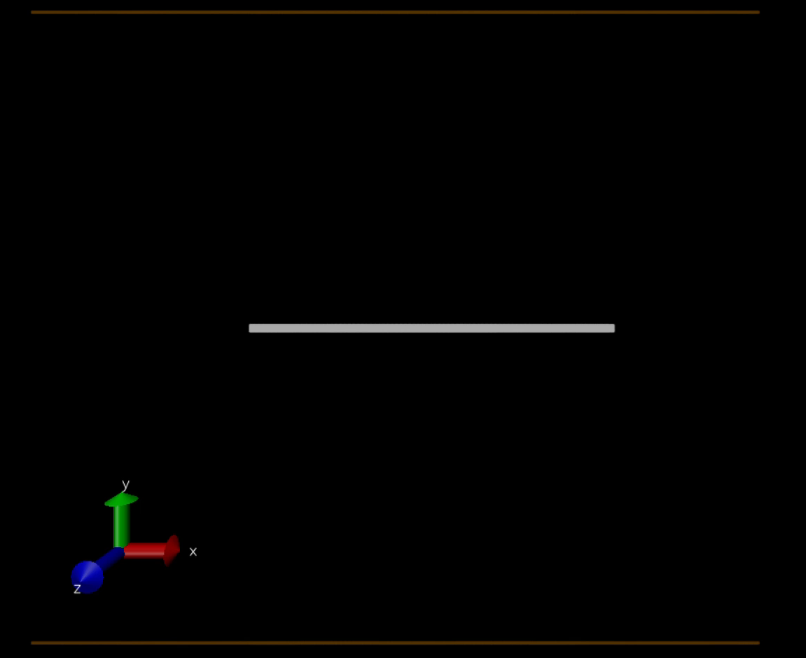


Molecular-Dynamics-Lattice-Gas
We aim to derive the LBM force term using MDLG:
Large Scale Atomic/Molecular Massively Parallel Simulator (LAMMPS)
2-D MD simulations with standard Lennard-Jones interaction potential
$$V\left(x\right)=4ε\left[{(\frac{σ}{x}}^{12})−({\frac{σ}{x}}^{6})\right]$$
Analyzing MD trajectories by imposing a lattice and obtain MDLG $n_{i}(x,t)$
(18)
$$F=F^{LJ}+mg$$
(19)
Fig 4. Initializing of a dense particles cloud
Deriving the LBM force term through a lattice gas model with molecular dynamics collision operator

Slide 15

Molecular-Dynamics-Lattice-Gas
In our MD simulations, the mean square displacement can typically be measured.
By stating it in terms of the velocity correlation, we may get a simplified reliance on a single parameter for our simple ideal gas system.
$$\left\langle v_{α}(t)v_{α}(0) \right\rangle =k_{B}Texp(−\frac{t}{τ})$$
(20)
Fig 5. Measured velocity correlation function compared to exponential fit
Deriving the LBM force term through a lattice gas model with molecular dynamics collision operator

Slide 16


Molecular-Dynamics-Lattice-Gas
Mean Square displacement:
$$\left\langle {(δx_{α}^{ })}^{2}\right\rangle =2\int_{0}^{t}{dt′(t−t^{′})\left\langle v_{α}(t^{′})v_{α}(0)\right\rangle }$$
(21)
$$\left\langle {(δx_{α}^{ })}^{2}\right\rangle =2k_{B}Tτ^{2}(e^{−\frac{t}{τ}}+\frac{t}{τ}−1)$$
(22)
(Fig 6. Measured mean square displacement compare with theoretical solution)
Higher volume fractions, however, lead this association to break since the velocity auto-correlation function no longer reproduces the mean-squared displacement contributions' right behavior.
(M. R. Parsa, A. Pachalieva and A. J. Wagner, Modern Physics C, Vol. 30, 2019 )
Deriving the LBM force term through a lattice gas model with molecular dynamics collision operator

Slide 17





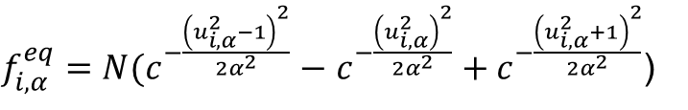
Molecular-Dynamics-Lattice-Gas
$f_{i,α}^{eq}=N(c^{−\frac{{\left(u_{i,α}^{2}−1\right)}^{2}}{2α^{2}}}−$ $c^{−\frac{{\left(u_{i,α}^{2}\right)}^{2}}{2α^{2}}}+c^{−\frac{{\left(u_{i,α}^{2}+1\right)}^{2}}{2α^{2}}}$)
$$+\frac{u_{i,α}−1}{2}\left[\operatorname{erf}\left(\frac{u_{i,α−1}}{\sqrt{2}a}\right)−\operatorname{erf}\left(\frac{u_{i,α}}{\sqrt{2}a}\right)\right]$$
(26)
$$+\frac{u_{i,α}−1}{2}\left[\operatorname{erf}\left(\frac{u_{i,α−1}}{\sqrt{2}a}\right)−\operatorname{erf}\left(\frac{u_{i,α}}{\sqrt{2}a}\right)\right]$$
$$^{∗}$$
$$a^{2}=\frac{\left\langle {(δx_{α}^{ })}^{2}\right\rangle }{{(∆x)}^{2}}$$
(27)
Fig 7. Measured equilibrium distribution as a function of mean square displacement
$$N=\frac{a}{\sqrt{2π}}$$
(28)
$^{∗}$(M. R Parsa and A J. Wagner , PR E 96, 2017)
Deriving the LBM force term through a lattice gas model with molecular dynamics collision operator

Slide 18
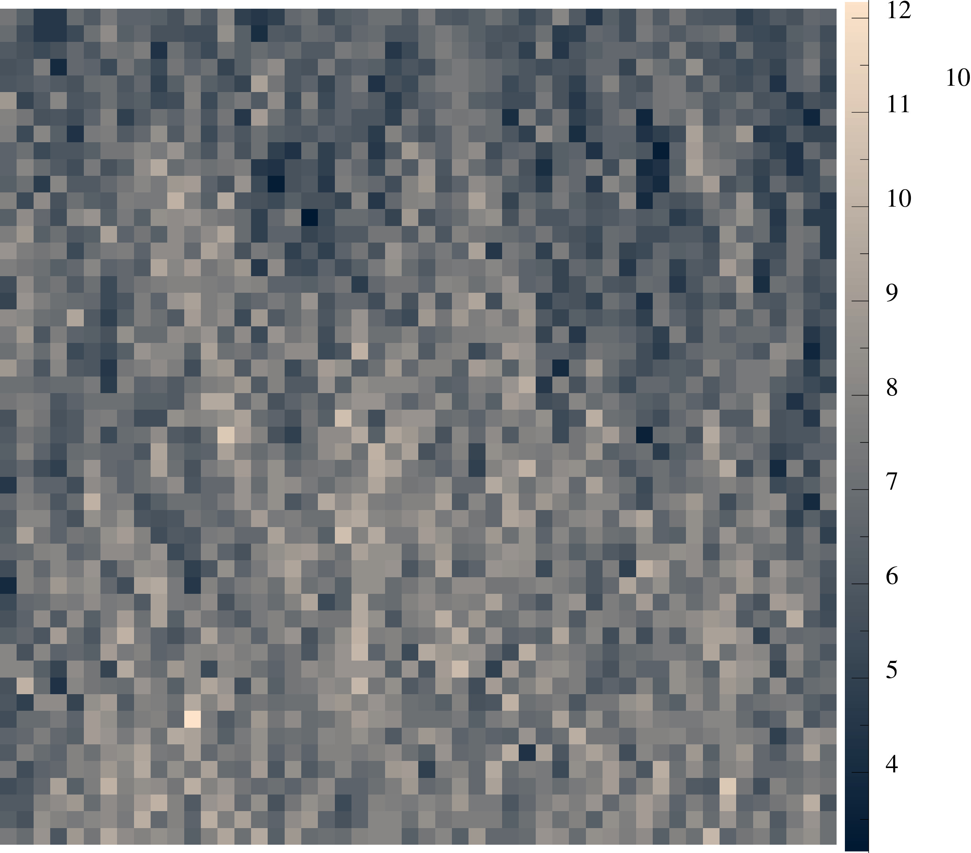
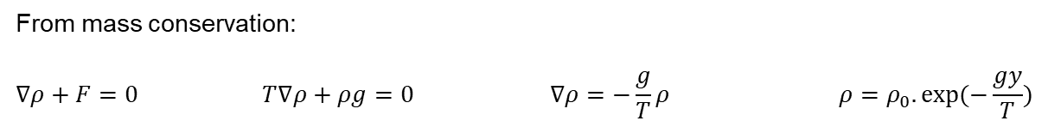
Deriving force term through MDLG
Fig 8. Measured density gradient as a function of height
Fig 9. Equilibrium distribution function using MDLG
From mass conservation:
$$∇ρ+F=0 T∇ρ+ρg=0 ∇ρ=−\frac{g}{T}ρ ρ=ρ_{0}.exp⁡(−\frac{gy}{T})$$
(29)
(30)
(31)
(32)
Deriving the LBM force term through a lattice gas model with molecular dynamics collision operator

Slide 19
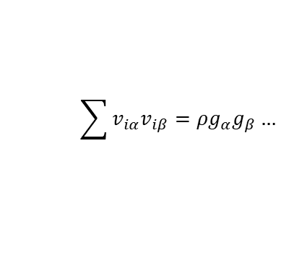

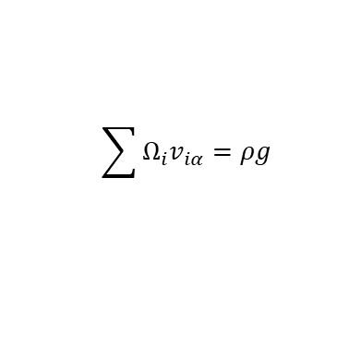
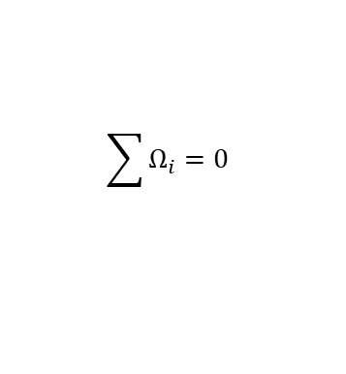


Deriving force term through MDLG
Obtaining MDLB by averaging :
$$f_{i}=\left\langle n_{i}(x,t)\right\rangle$$
(33)
Our aim is to analyze the force term in the described ideal gas system
$$f_{i}\left(x+v_{i},t+∆t\right)=f_{i}\left(x,t\right)− \frac{1}{τ}\left(f_{i}\left(x,t\right)−f_{i}^{eq}\left(x,t\right)\right)+F_{i}$$
(34)
$$f_{i}\left(x+v_{i},t+∆t\right)=f_{i}\left(x,t\right)+ Ω_{i}$$
(35)
$$Ω_{i}=Collisions+Forcing$$
(36)
$$\sum{Ω_{i}}=0$$
(37)
$$\sum{Ω_{i}v_{iα}}=ρg$$
(38)
$$\sum{v_{iα}v_{iβ}}=ρg_{α}g_{β}…$$
(39)
We can evaluate the same system using BGK and MRT collision LBM
Deriving the LBM force term through a lattice gas model with molecular dynamics collision operator

Slide 20


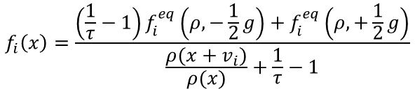

Deriving force term through MDLG
$$F_{i}=f_{i}^{eq}\left(ρ,\vec{u}+\vec{g}\right)−f_{i}^{eq}\left(ρ,u\right)$$
(40)
$$f_{i}\left(x+v_{i},t+∆t\right)=f_{i}\left(x,t\right)− \frac{1}{τ}\left(f_{i}\left(x,t\right)−f_{i}^{eq}\left(x,t\right)\right)+f_{i}^{eq}\left(ρ,\vec{u}+\vec{g}\right)−f_{i}^{eq}\left(ρ,u\right)$$
(41)
$$ρ=ρ_{0}.exp⁡(−\frac{gy}{T})$$
(32)
$$f_{i}\left(x+v_{i}\right)=f_{i}\left(x\right).\frac{ρ(x+v_{i})}{ρ(x)}$$
(43)
$$f_{i}\left(x\right)=\frac{\left(\frac{1}{τ}−1\right)f_{i}^{eq}\left(ρ,−\frac{1}{2}g\right)+f_{i}^{eq}\left(ρ,+\frac{1}{2}g\right)}{\frac{ρ(x+v_{i})}{ρ(x)}+\frac{1}{τ}−1}$$
Analytical form of $f_{i}$
(44)
… !
Deriving the LBM force term through a lattice gas model with molecular dynamics collision operator

Slide 21
Thank you !
Questions ?

